Slide 1
Credit EDA Case Study
By – Vijaykumar Rangvani
Shruti Gupta

Slide 2
Current Application Analysis

Slide 3
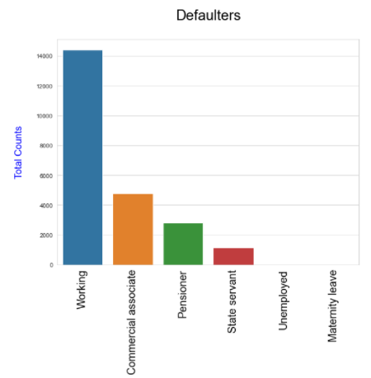
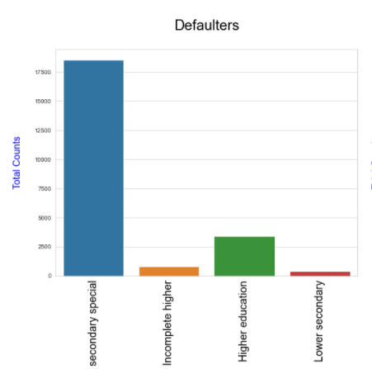
Category of Defaulters based on income and education
Working Clients are highest number of defaulters from Income category .
Clients with qualification of Secondary education are highest number of defaulters from Education category .

Slide 4
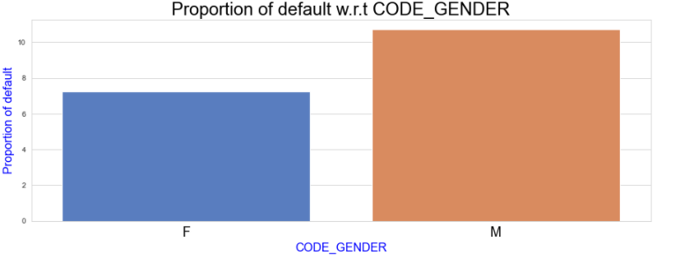
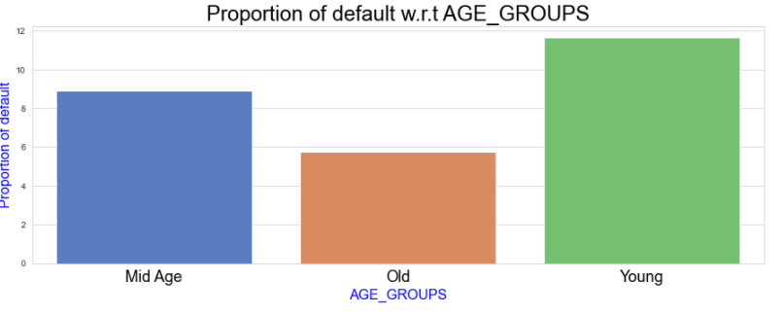
Proportion of Defaulters based on gender and Age Groups
Proportion of Male category is higher in defaults as compared to females
Proportion of Default increases in Age.

Slide 5
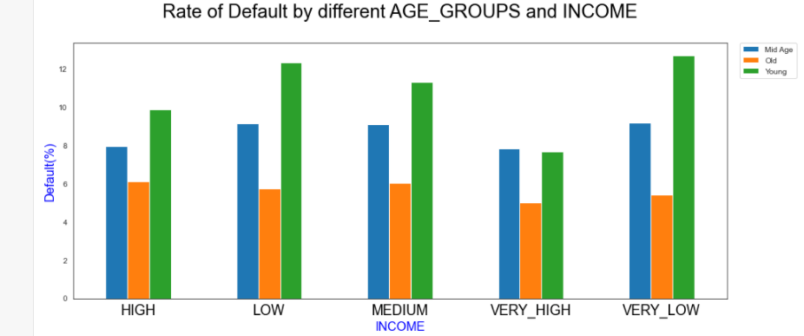
• Young people are highest number of defaulters from Age category .
• Low income group clients are highest number of defaulters from Income category .
• Old Age group is recommended group as they have less number of defaults regardless of income.

Slide 6
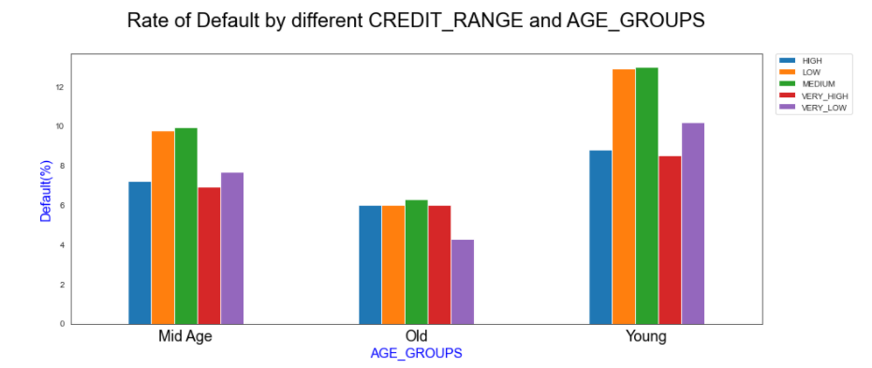
• Age and Credit amount are inversely proportional. Chances of defaults are higher for low and medium credit amount.
• Young clients with low and medium credit amount are more likely to default.
•Young Clients with low and medium credit amount posses high chance of default.

Slide 7
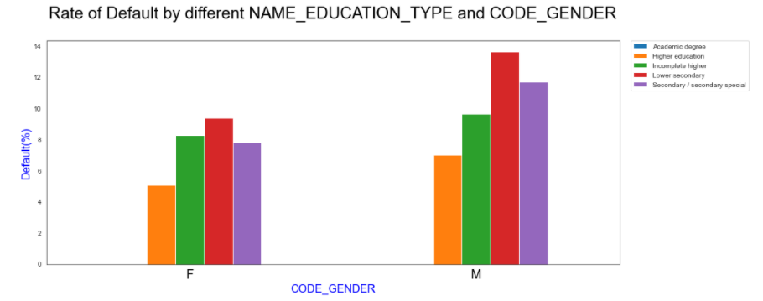
• Male clients with lower secondary and Secondary education are more likely to default.
•Clients with high lower secondary education posses high rate of default.
•Female Category is recommended category on basis of Education also number of defaulters are same across all education groups.

Slide 8
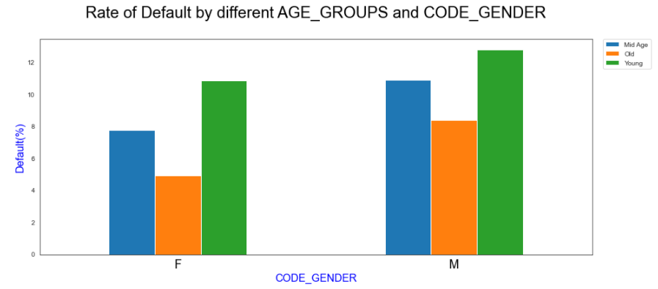
• Young Category is risky as it posses high rate of default for both genders.
•Female category is again the recommend group on basis of Age group also.
•Old Aged Female is the safest group as it has least chance of default whereas young male category is the most risky..

Slide 9
Previous Application Analysis

Slide 10
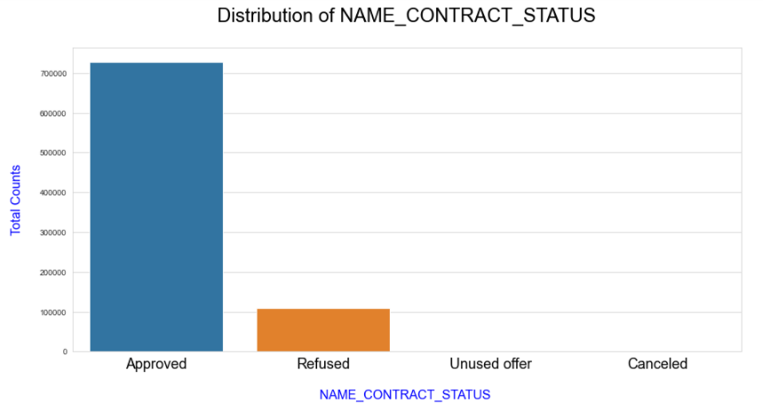
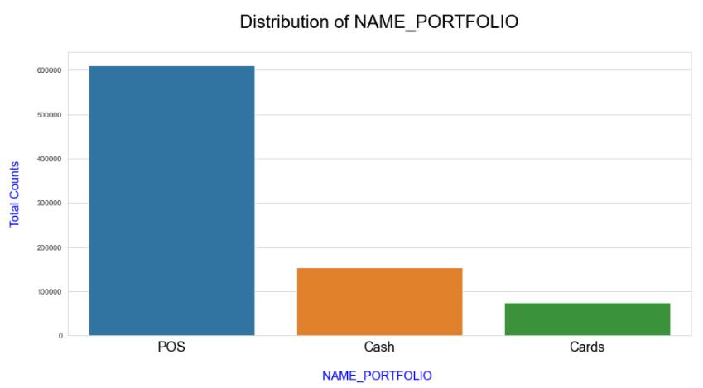
• Count of Approved status is very much high when compared to other types like rejected or cancelled.
• As per previous data, Count of POS type loans was higher in comparison to other types.

Slide 11
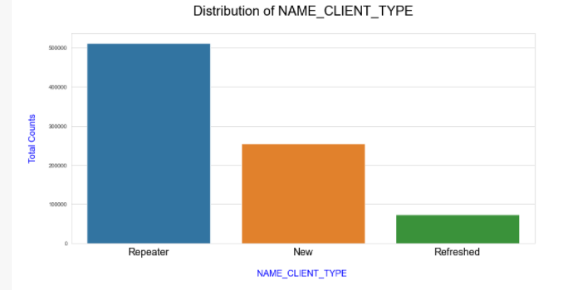
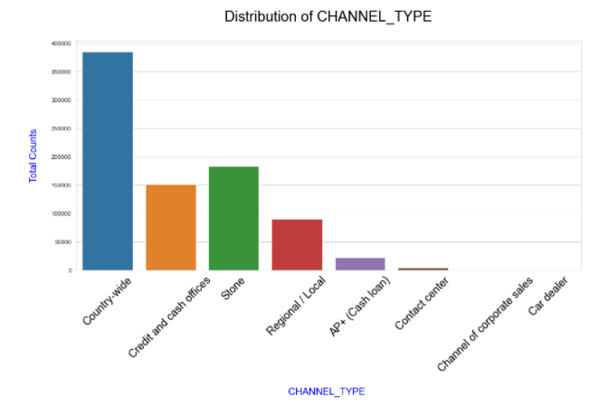
• - Number of Repeater clients is higher when compared to new clients..
• As per previous data, Country-wide channel is most popular channel type.

Slide 12
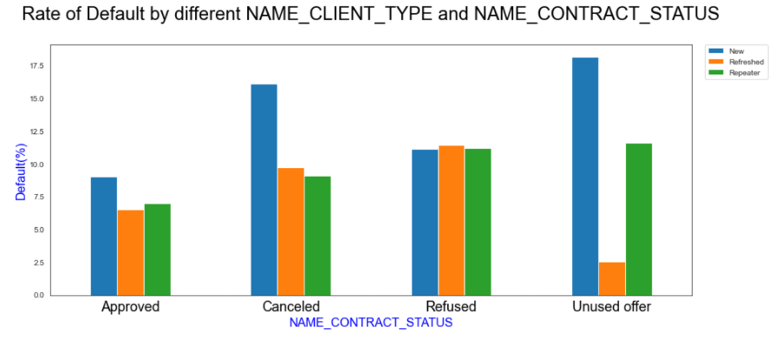
• New clients are more likely to default in comparison to repeater clients..
•Previously, Cancelled, refused or Unused offer category client should be avoided .
•Previously approved loan category is safest and recommended category among all.

Slide 13
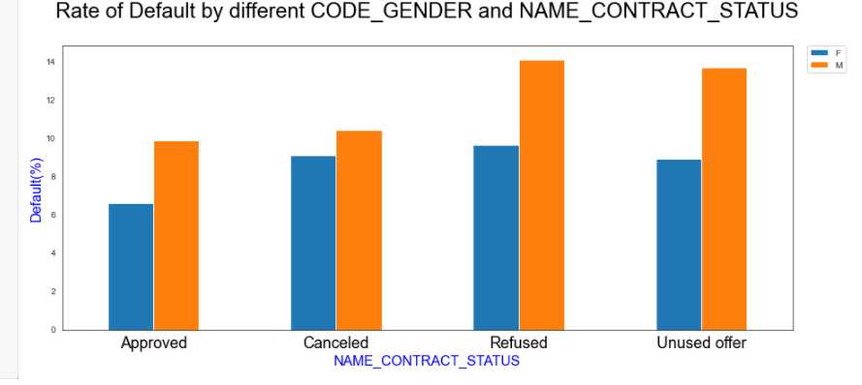
• Male category is having higher ratio of default when compared to female category.
• Male clients with previous application as refused should be avoided as it is risky category .
•Previously approved loan category is safest and recommended category among all.

Slide 14
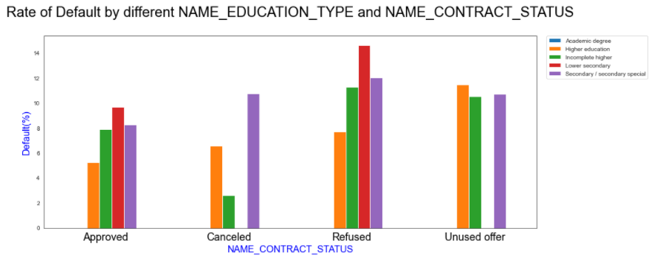
•Highest number of defaults in current loan are made by clients who have lower secondary education with refused previous loan.
•Previously, Refused category of the Contract should be avoided as it has higher chances of defaults
• People with Academic Degree are considered to be safe category.

Slide 15
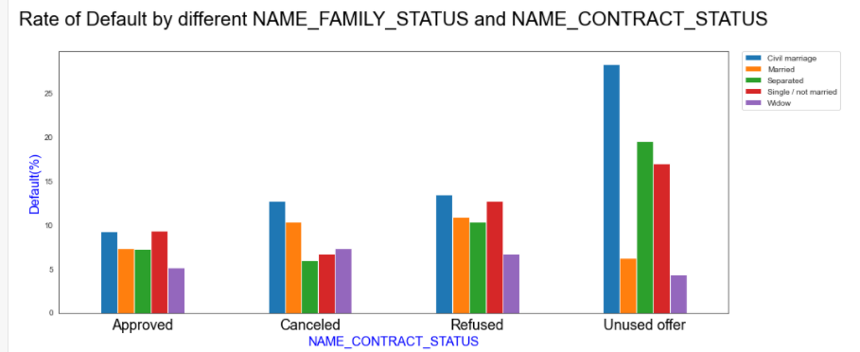
• Higher chances of default in current loan are made by clients who have Civil marriage with unused previous loan offer. Recommended to avoid this category.
•Widow category can be target as it has least defaults among all categories.
•Again Approved category is best among all in terms of Family Status also.

Slide 16
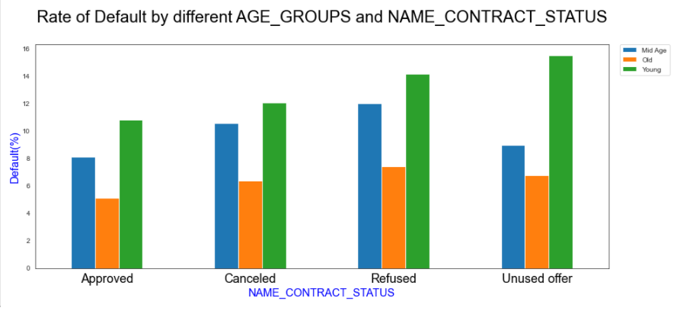
- Highest number of defaults in current loan are made by clients who are young with unused previous loan offer.
- Highest number of defaults in current loan are made by clients who are young with unused previous loan offer.
• - Highest number of defaults in current loan are made by clients who are young with unused previous loan offer.
•Old people have least default rate across all Contract types.
• Young age across all contract type has higher default rate as compared to all the others age groups.

Slide 17
Conclusion

Slide 18
Safe Clients
Category or group that bank can target or approve loan for them. (Minimal chances of Default)
• Old Age Group Clients
• State servant Clients.
• High income category Clients.
• Female clients in old age Group.
• Client having higher education.
• Clients with previous loan status as approved.
• Widow who has unused previous loan status.

Slide 19
Risky Clients
Category or group that bank can avoid to approve loans as these clients(High chances of Default)
- Client having Lower secondary education.
- Male clients with civil marriage.
- Clients with previous loan status as cancelled or refused.

Slide 20
Thank You

